Slide 1
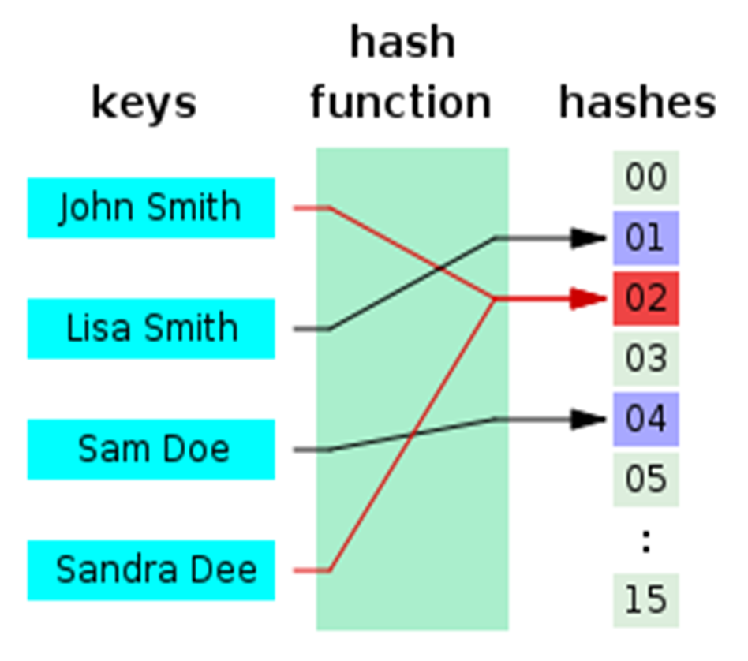
Hashing and Hash Functions
Cryptographic Hash Functions

Slide 2

What is Hashing?
Text
Hashed text
Some text
Some text
Some text
Some text
Some text
Some text
Some text
20c9ad97c081d63397d7b685a412227a40e23c8bdc6688c6f37e97cfbc22d2b4d1db1510d8f61e6a8866ad7f0e17c02b14182d37ea7c3c8b9c2683aeb6b733a1
Hash function

Slide 3
Hash Functions
Hash functions:
Map data of arbitrary size input to result of fixed size
Returned result is called hash value, hash code, digests, or simply hash
Irreversible by design
Cannot reproduce the input from the result
Used in cryptography and in programming

Slide 4
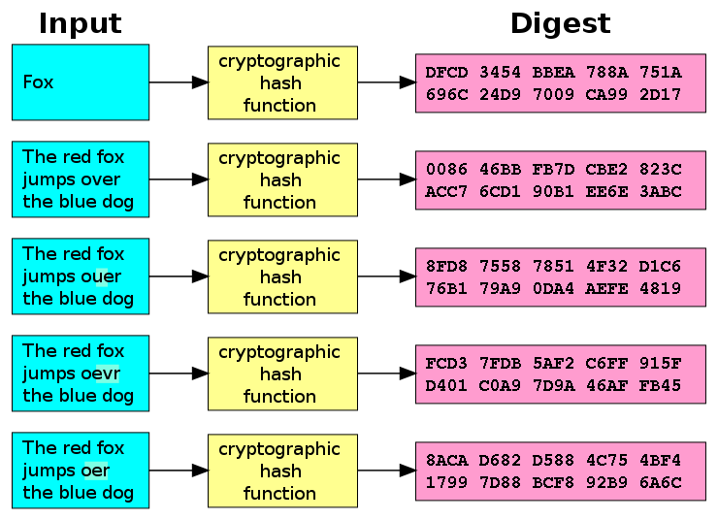
Cryptographic Hash Function
Cryptographic hash function
One-way hash function
Infeasible to invert
Extremely little chance to find a collision
Let's have h = hash(t)
It should be extremely hard to find an input t', such that hash(t') = h

Slide 5

The Ideal Cryptographic Hash Function
Deterministic
The same message always results in the same hash
Quick
Fast to compute the hash value for any given message
Small change to a message changes totally the hash value
Irreversible
Generate a message from its hash value is infeasible
No significantly better way than brute force (try all messages)
No collisions: cannot find two different messages with the same hash

Slide 6
Cryptographic Hash Functions: Applications
Verifying the integrity of files / documents / messages
E.g. SHA256 checksum may confirm that certain file is original
Password storing and verification
Keep hashed passwords (with salt) in the DB instead in clear text
Generate an almost unique ID of certain document / message
Pseudorandom generation and key derivation
Proof-of-work (PoW) algorithms
Find a number p, such that hash(x + p) holds 10 leading zeroes

Slide 7
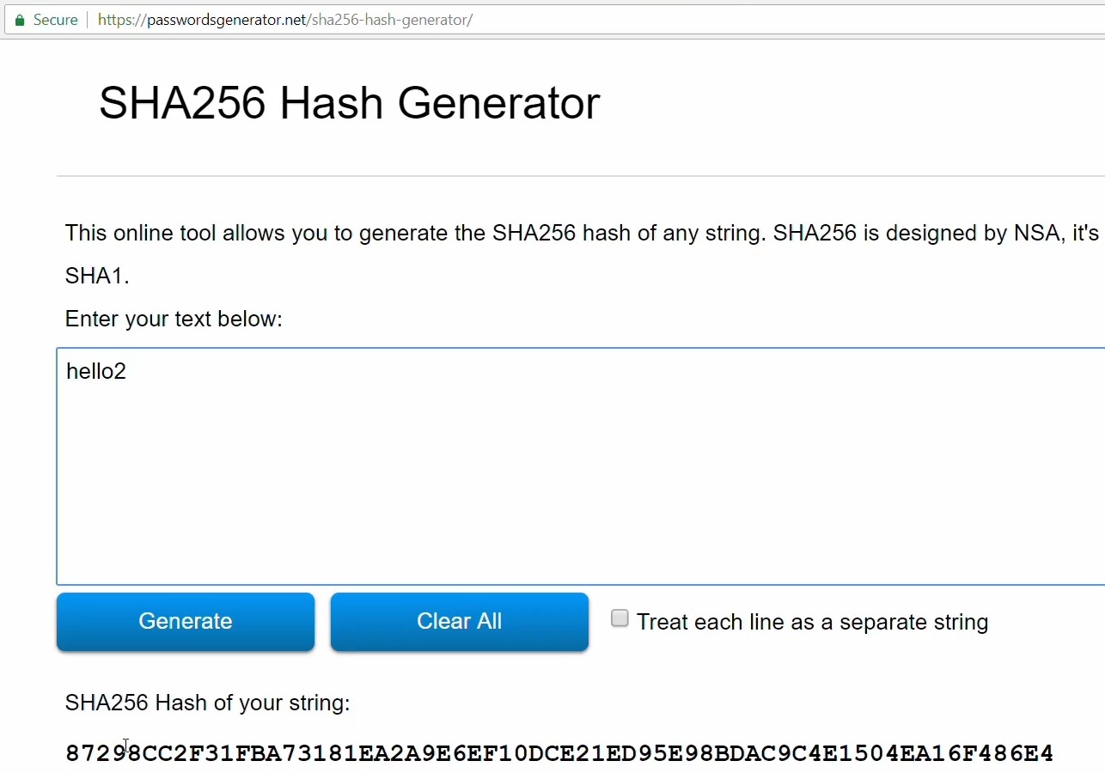
Live Demo
SHA-256
https://passwordsgenerator.net/sha256-hash-generator

Slide 8

Hashing and Hash Functions
Try the Demo!

